Slide 1
Heap Sort
BY: Mariam Zaki
ID: 220375
Faculty: Computer Science
Major : SE

Slide 2
TABLE OF CONTENTS
01
02
03
04
INTRODUCTION
Analyize
Implementation
Examples

Slide 3
What is Heap Sort?
Heap sort is a sorting algorithm that uses a binary heap data structure. It works by first creating a binary heap from the elements that we need to sort. Also, Heap sort is a versatile sorting algorithm that excels at organizing elements with a time complexity of O(n log n). It accomplishes this by using a binary heap data structure, allowing for efficient identification of the maximum (or minimum) element, unlike selection sort's linear scans. This significantly reduces the time it takes to find the next element for the sorted region.

Slide 4
Heaps are complete binary trees implemented using an array
Parent of a node i is ⌊i2⌋⌊𝑖2⌋
Left child of the node i is 2∗i2∗𝑖
Right child of the node i is (2∗i)+1(2∗𝑖)+1
Max-heap property → The value of a node is greater than or equal to the value of its children i.e., A[Parent[i]]≥A[i]𝐴[𝑃𝑎𝑟𝑒𝑛𝑡[𝑖]]≥𝐴[𝑖] for all nodes i>1.
Min-heap property → The value of a node is either smaller or equal to the value of its children i.e., A[Parent[i]]≤A[i]𝐴[𝑃𝑎𝑟𝑒𝑛𝑡[𝑖]]≤𝐴[𝑖] for all nodes i>1.
HEAPIFY is a function used to maintain the heap property of any heap. It is applied to a node when the children of the node are following the property of a heap but the node itself may be violating it. It runs in O(logn)𝑂(log⁡𝑛) time.
BUILD-HEAP is a function used to make a heap from an array. It runs in O(n)𝑂(𝑛) time

Slide 5
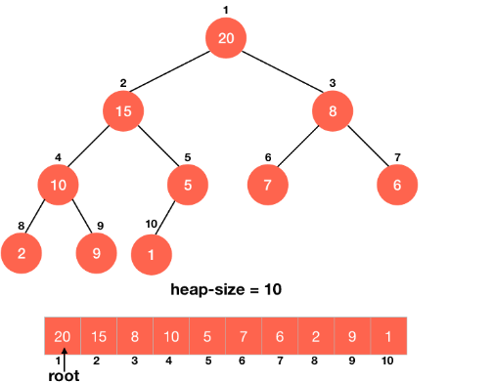
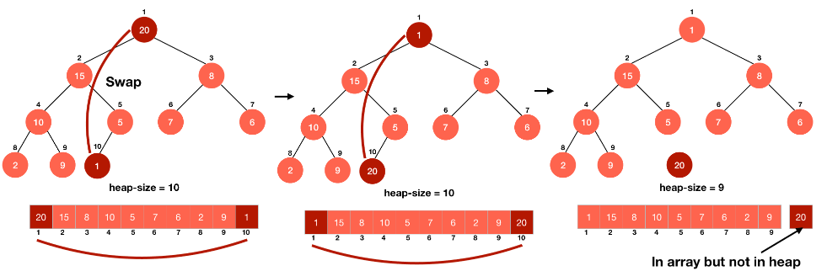
Working of Heapsort Heap sort is implemented using a max-heap. In a max-heap, the maximum element is at the root of the tree and is also the first element of the array 1st ex: We want this maximum element to be at the last element of our sorted array. So, we swap it with the last element and then discard this element from the heap by reducing the size of the heap. 2nd ex: We have correctly put the largest element at the correct position, but in doing so, we have disturbed our heap or more precisely, the root of the heap because we haven't touched any child of the root yet. Thus they are still following the max-heap property.

Slide 6
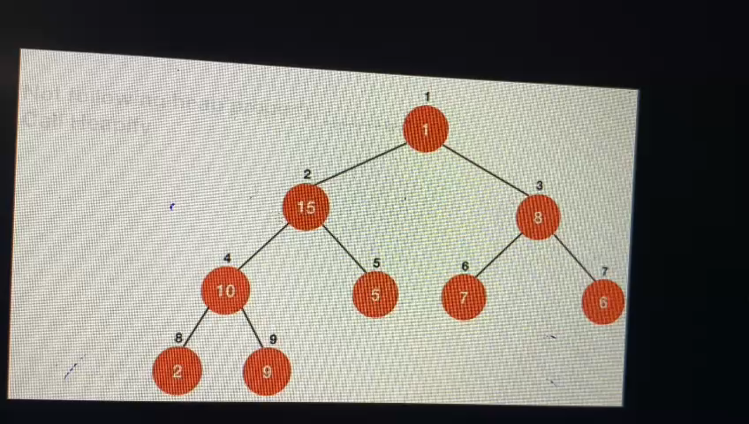
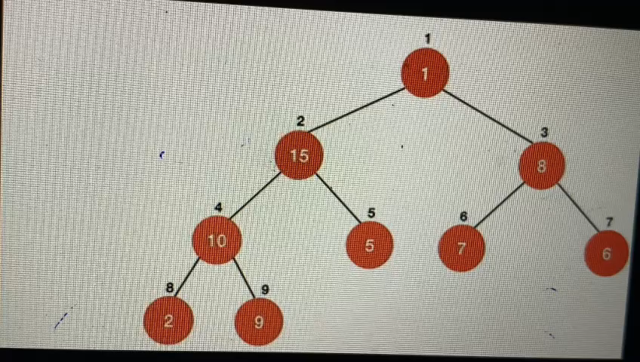
We can easily deal with this problem by calling HEAPIFY on the root of the tree and that will make our tree a max-heap again, but this time the largest element won't be the part of the heap

Slide 7
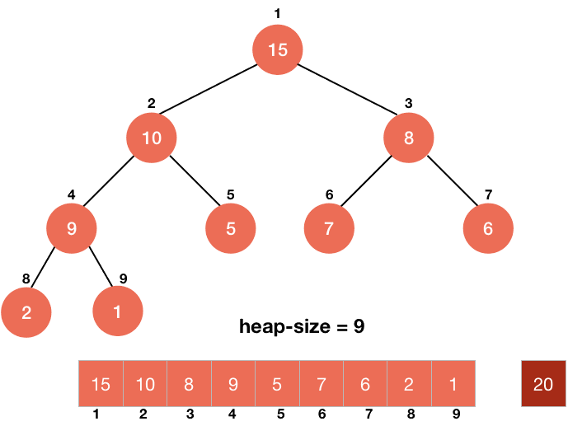
Now, we will just repeat this process until every element of the heap is correctly placed in sorted order

Slide 8
Coding Heapsort
We can easily implement the above logic in a code. We have to swap the first element of the array with the last element of the heap till the heap exists or the size of the heap is not 0.
while A.heap_size > 0 swap(A[1], A[heap_size])
After this, we just have to decrease the size of the heap by 1 to exclude the last element (largest element) form the heap.
A.heap_size = A.heap_size-1
The last part is to make the array a max-heap again by calling MAX-HEAPIFY function on the root because only the root is disturbed in the entire process.
MAX-HEAPIFIY(A, 1)

Slide 9
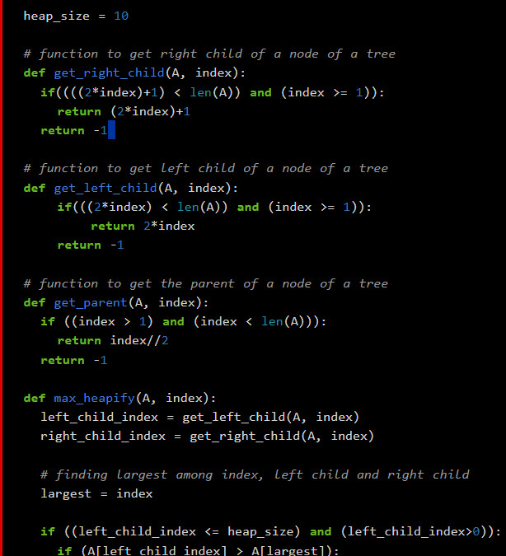
Code

Slide 10
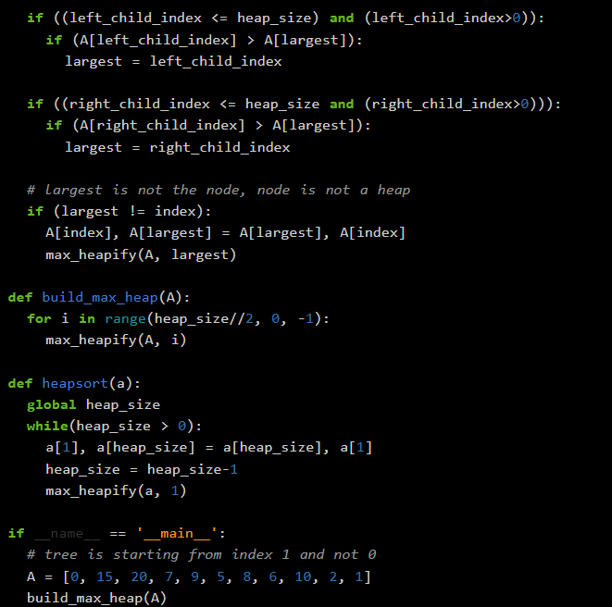
Code

Slide 11
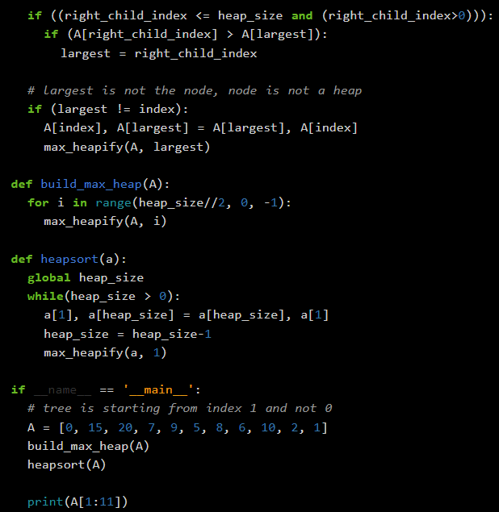
Code

Slide 12
The analysis of the code is simple. There is a while loop which is running n times and each time it is executing 3 statements. The first two statements (swap(A[1], A[A.heap_size]) and A.heap_size = A.heap_size-1) will take a constant time but the last statement i.e., MAX-HEPAPIFY(A, 1) is going to take O(lgn)𝑂(lg⁡𝑛) time. So, the algorithm is going to take a total of O(nlogn)𝑂(𝑛log⁡𝑛) time.
Analysis of Heapsort

